Slide 1
Sustainable Energy

Slide 2
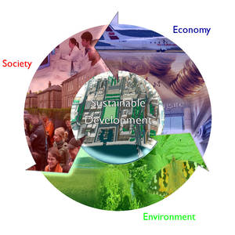
What is Sustainable Development?
Let’s break it down…

Slide 3
What is Development?
It is the process of expanding human potential.
In other words…
It is “growth”
What do we need to grow?
It involves getting rid of poverty and preventable diseases
It provides educational and economic opportunities

Slide 4
What is Sustainability?
The ability to maintain a lifestyle without compromising the lifestyle of future generations

Slide 5
So what is Sustainable Development?
Meeting people’s current needs without compromising the ability of future generations to meet their own needs
It requires that people protect the environment so that development can continue in the future

Slide 6
Why is Energy Essential?
People need energy to satisfy their basic needs for clean water, food, sanitation and housing.

Slide 7
Energy Facts:
One in Five people still lacks access to modern electricity
Energy is the dominant contributor to climate change
It accounts for 60% of total greenhouse gas emissions

Slide 8
Types of Energy Sources
Oil Natural Gas Natural gas is a nonrenewable fossil fuel that is closely related to oil. It is drilled from the same wells as crude oil or it is later removed in the distilling process.
Coal Nuclear Bioenergy Biomass is organic material which is regenerated over time, such as wood, municipal waste, and alcohol fuels derived from agricultural crops.
Geothermal Hydropower -Geothermal energy is derived from heat within the earth. Energy is found deep in the earth in the form of steam, naturally heated water, and rocks that touch magma deep in the earth’s crust. Solar Wind Hydrogen Coal-based fuel Wood
http://www.portal.state.pa.us/portal/server.pt/community/types_of_energy/4568

Slide 9
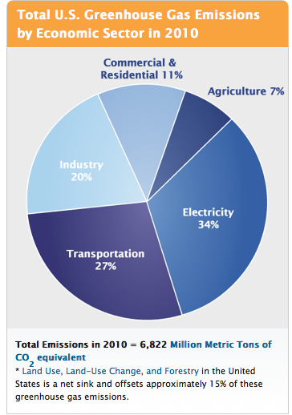

Slide 10
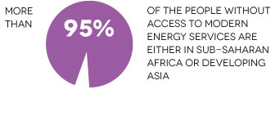
Sustainable energy—energy that is accessible, cleaner and more efficient—powers opportunity.

