Slide 1
NATURAL DISASTERS!
EARTHQUAKES
WILDFIRES
VOLCANIC ERUPTIONS
TORNADOES
DROUGHT
FLOODS
AVALANCHE
TSUNAMI
BLIZZARD
EPIDEMICS/ILLNESSES
HURRICANES
LANDSLIDES

Slide 2
Natural Disasters
November 13 & 14, 2012

Slide 3
What is a Natural Disaster?
* A natural disaster is the consequence of a natural, hazardous event, occurring when human activities and natural phenomenon come together.

Slide 4
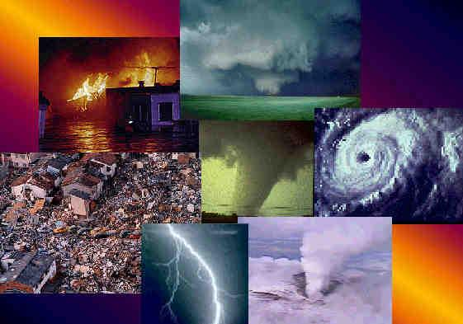
What are the different types of Natural Disasters?
Earthquakes
Volcanoes
Floods
Tsunamis
Tornadoes
Hurricanes
Avalanches
Blizzards
Wildfires

Slide 5
Earthquakes
An earthquake is the result of a sudden release of energy in the earth's crust.
Secondary effects:
Fires, tsunamis, building collapse, etc.
Where do they occur?
Along plate boundaries
Along faults (cracks in the earth's crust)

Slide 6
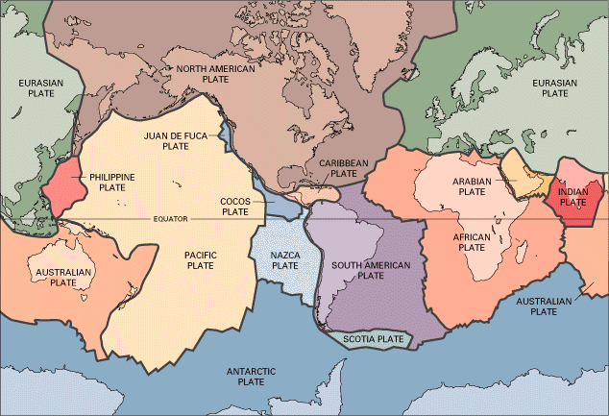

Slide 7
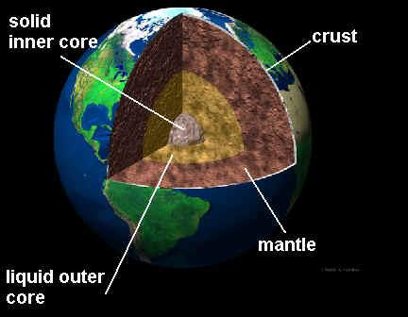
Volcanoes
A volcanoe erupts when magma escapes from the center of the earth.
Many of the world’s volcanoes occur along the edges of plate boundaries.

Slide 8
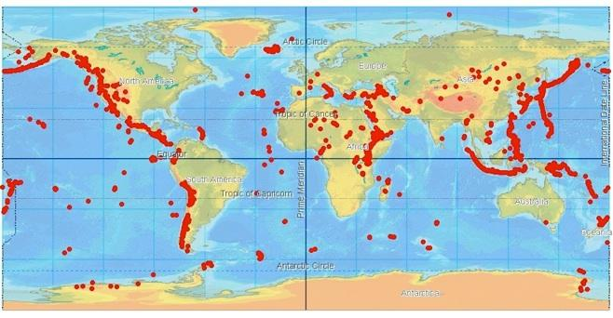

Slide 9
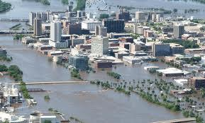
Floods
A flood occurs when
water overflows its
normal boundaries, and
submerges land.

Slide 10
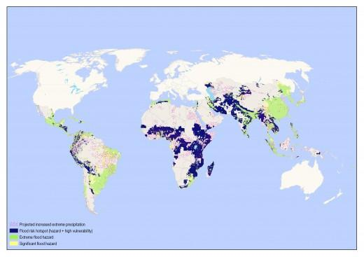

Slide 11
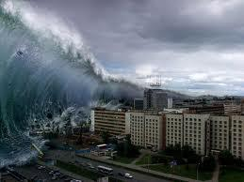
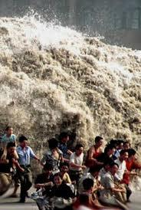
Tsunamis
Tsunamis are caused by
undersea earthquakes.
Tsunamis can also be caused by
coastal landslides.

Slide 12
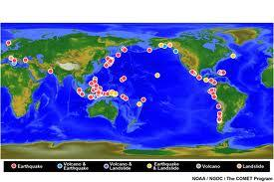

Slide 13
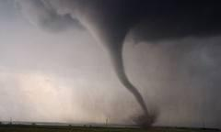
Tornadoes
A tornado is a violent, dangerous, rotating column of air that is in contact with both the surface of the earth and a cumulonimbus cloud.
Averages:
Wind speed <110mph
250 feet across

Slide 14
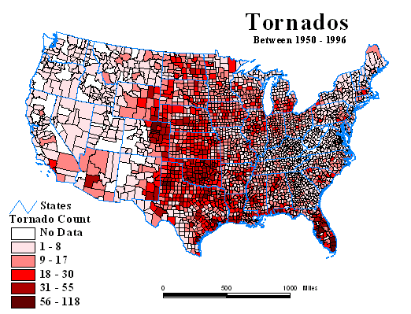
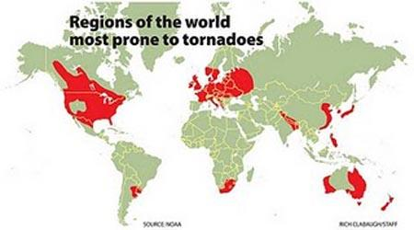

Slide 15
Hurricanes
Typhoon, cyclone, tropical cyclone
Hurricanes are huge storms that can be up to 600 miles wide, and have winds up to 200 mph.
They are generated by:
Warm ocean water (warmer than 80 degrees)
Upward lifting winds
Air that cools quickly as it rises
Winds that move the entire storm system

Slide 16
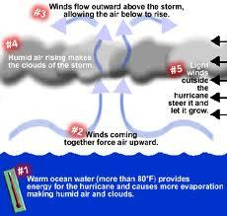
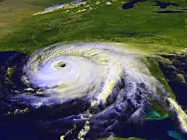
Hurricanes cont.

Slide 17
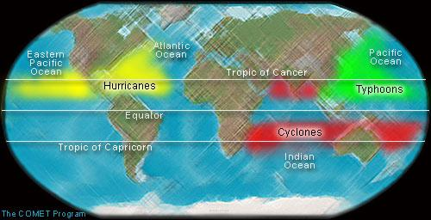

Slide 18
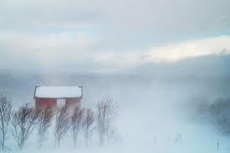
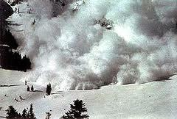
Blizzards & Avalanches
Blizzards:
Heavy snow
Strong winds
Avalanches:
Layers of snow build up
Layers slip off the other

Slide 19
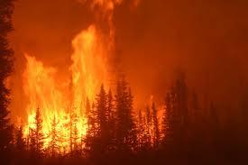
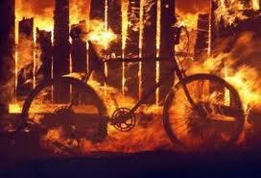
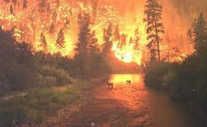
Wildfires
Wildfires are uncontrolled
fires that endanger the
lives of plants, animals,
and humans.

Slide 20
Think About it!
How do Natural Disasters have an impact on the other MUN Topics?
Agriculture
Water
Cities
Energy

Slide 21
Preparing for Natural Disasters
Is it possible to prevent a natural disaster? Why or why not?
What can we do to prepare for natural disasters?

Slide 22
Research!
Now that we have discussed natural disasters and their impact around the world, work with your partner to RESEARCH and ANSWER the questions at the bottom of the worksheet.
You have 10 minutes!

Slide 23
Think About It!
Turn to page 7 of your MUN Packet.
With your assigned group, think of a creative way that you could prevent or prepare for the assigned natural disaster.
Use the worksheet to help you write your thesis and antithesis. (write on a new piece of paper!)

